Slide 1
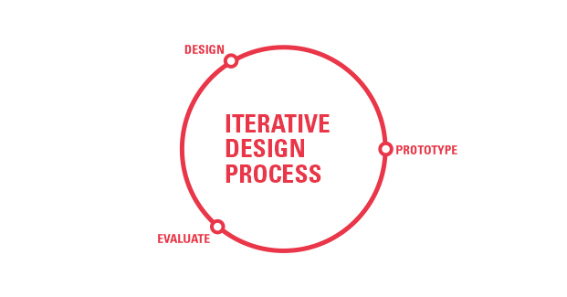

Slide 2
Making something happen
Turning on a light

Slide 3
Making something happen
Turning on a light
Turning on multiple lights
https://flickr.com/photos/grendelkhan/

Slide 4
Making something happen
Turning on a light
Turning on one set of lights for 30 seconds, another for 5 seconds, and another for 30 seconds
https://flickr.com/photos/grendelkhan/

Slide 5
Detecting something
Sensing temperature
https://flickr.com/photos/renaissancechambara/

Slide 6
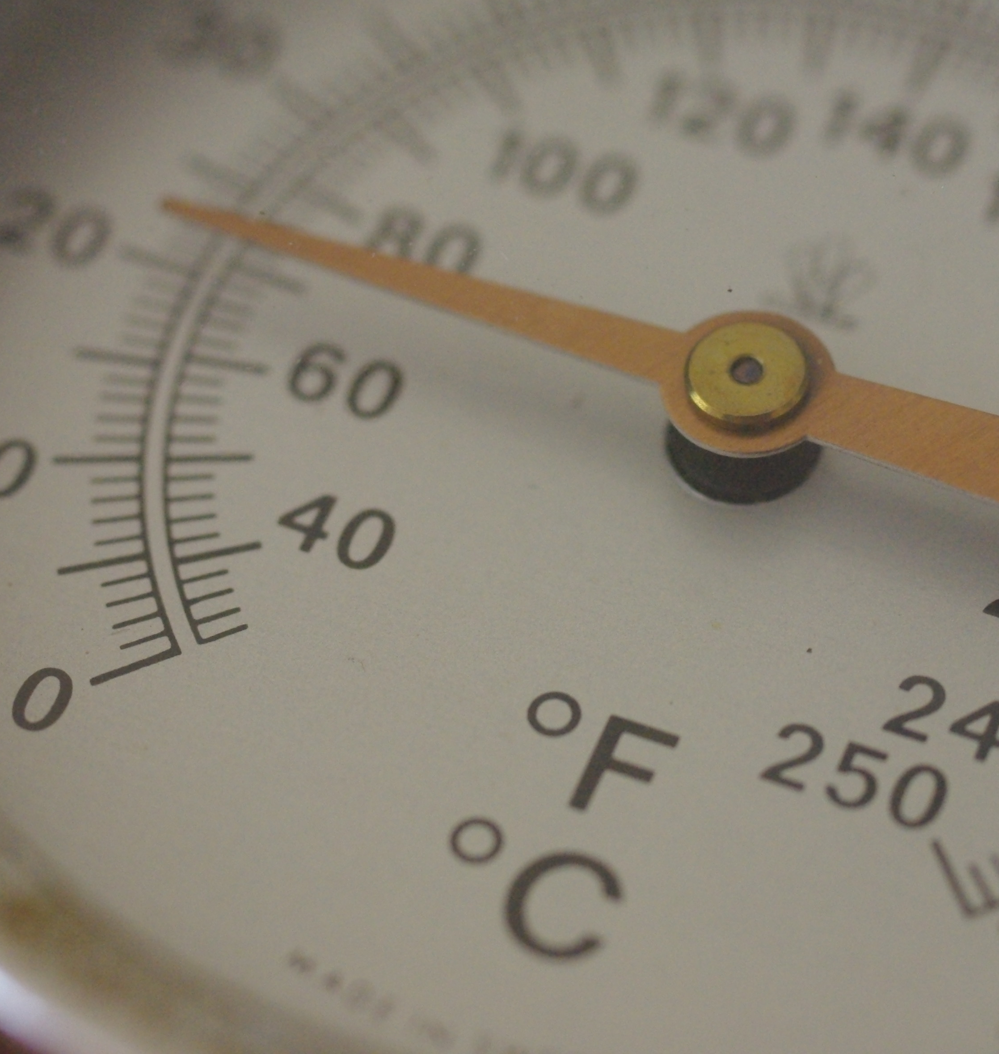
Detecting something
Sensing temperature
https://flickr.com/photos/renaissancechambara/

Slide 7
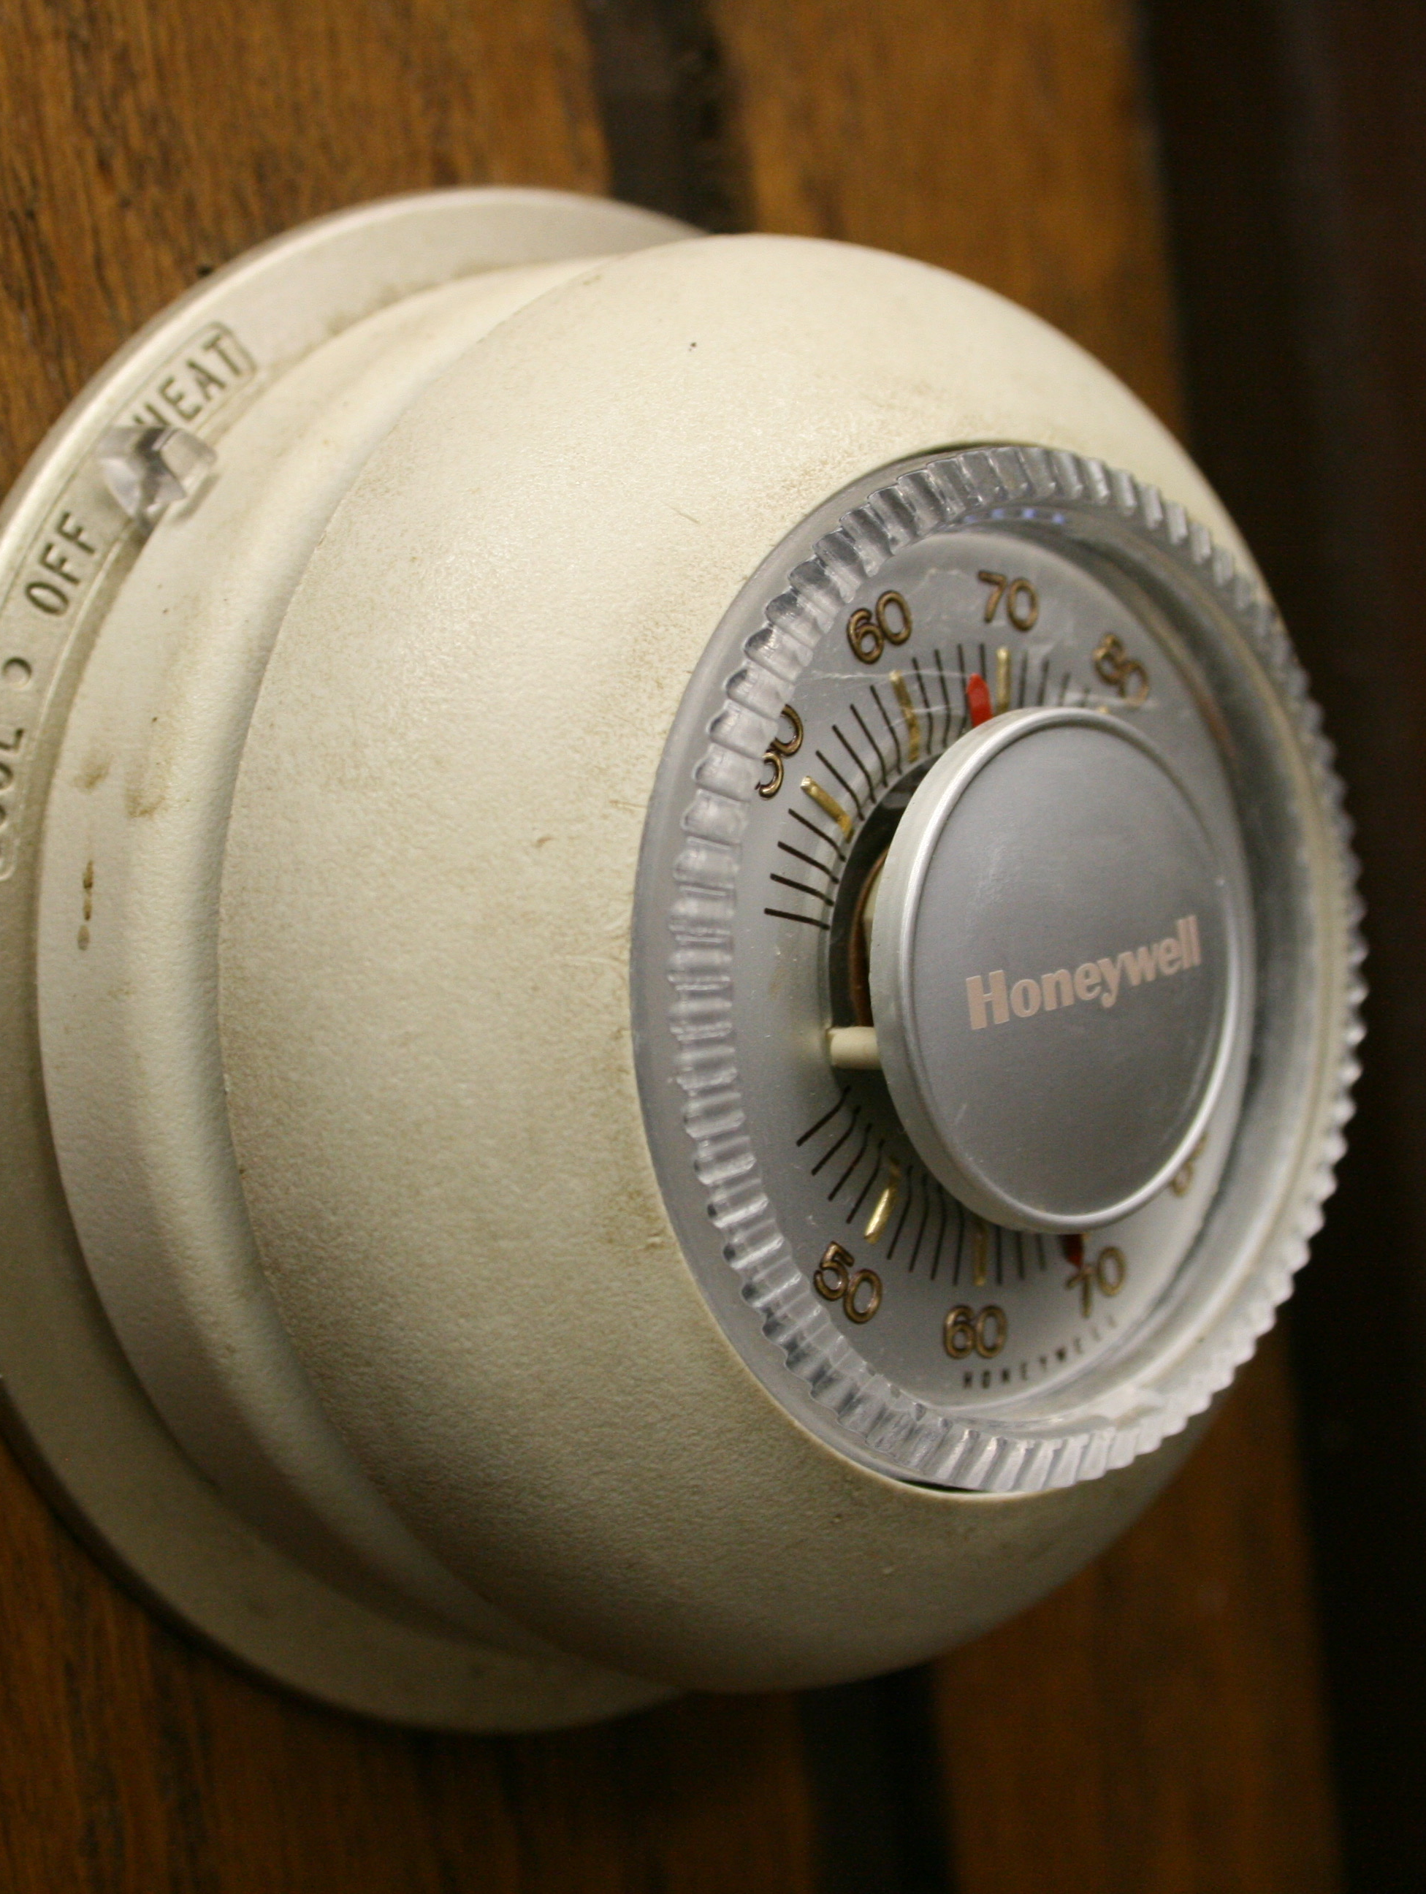
Making something happen based on what was detected
Sensing temperature
Turning on a furnace if the temperature is below 60ºF and turning on the air conditioner if the temperature is above 77ºF
https://flickr.com/photos/midnightcomm/

Slide 8
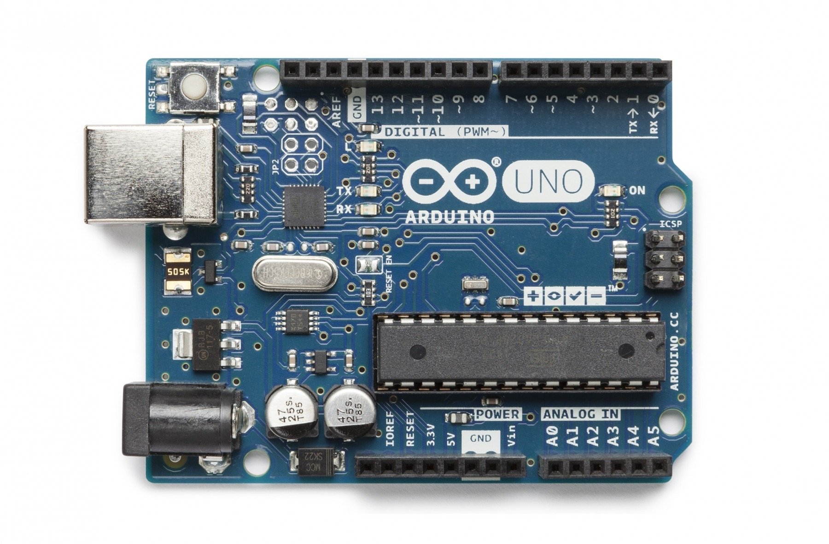
Arduino
Programmable microcontroller
Programs are called sketches
Loaded across USB
3 inputs and 3 outputs
LittleBits version of Arduino Leonard
https://www.arduino.cc/en/Main/Products

Slide 9
Arduino
Programmable microcontroller
Programs are called sketches
Loaded across USB
6 analog inputs and 14 digital inputs/outputs
https://www.arduino.cc/

Slide 10
Arduino
Programmable microcontroller
Programs are called sketches
Loaded across USB
3 inputs and 3 outputs
LittleBits version of Arduino Leonard
https://www.arduino.cc/en/Main/Products

Slide 11
Arduino
Programmable microcontroller
Programs are called sketches
Loaded across USB
3 inputs and 3 outputs
LittleBits version of Arduino Leonard
https://www.arduino.cc/en/Main/Products
ATmega328P (Brain)

Slide 12
Arduino
Programmable microcontroller
Programs are called sketches
Loaded across USB
3 inputs and 3 outputs
LittleBits version of Arduino Leonard
https://www.arduino.cc/en/Main/Products
ATmega328P (Brain)
32KB

Slide 13
Arduino
Programmable microcontroller
Programs are called sketches
Loaded across USB
3 inputs and 3 outputs
LittleBits version of Arduino Leonard
https://www.arduino.cc/en/Main/Products
ATmega328P (Brain)
32KB
Inputs A0-A5

Slide 14
Arduino
Programmable microcontroller
Digital I/O 0-13
Programs are called sketches
Loaded across USB
3 inputs and 3 outputs
LittleBits version of Arduino Leonard
https://www.arduino.cc/en/Main/Products
ATmega328P (Brain)
32KB
Inputs A0-A5

Slide 15
Arduino
/*
Blink
Turns on an LED on for one second, then off for one second, repeatedly.
Most Arduinos have an on-board LED you can control. On the Uno and
Leonardo, it is attached to digital pin 13. If you're unsure what
pin the on-board LED is connected to on your Arduino model, check
the documentation at http://arduino.cc
This example code is in the public domain.
modified 8 May 2014
by Scott Fitzgerald
*/
// the setup function runs once when you press reset or power the board
void setup() {
// initialize digital pin 13 as an output.
pinMode(5, OUTPUT);
}
// the loop function runs over and over again forever
void loop() {
digitalWrite(13, HIGH); // turn the LED on (HIGH is the voltage level)
delay(1000); // wait for a second
digitalWrite(13, LOW); // turn the LED off by making the voltage LOW
delay(1000); // wait for a second
}
Comments are human readable

Slide 16
Arduino
void setup() {
pinMode(5, OUTPUT);
}
void loop() {
digitalWrite(13, HIGH);
delay(1000);
digitalWrite(13, LOW);
delay(1000);
}

Slide 17
Arduino
void setup() {
pinMode(5, OUTPUT);
}
void loop() {
digitalWrite(13, HIGH);
delay(1000);
digitalWrite(13, LOW);
delay(1000);
}
Setup runs one time
Loop runs forever

Slide 18
Arduino
void setup() {
}
void loop() {
}
Setup runs one time
Loop runs forever

Slide 19
Arduino
void setup() {
instructions go between curly braces ;
}
void loop() {
instructions go between curly braces ;
}

Slide 20
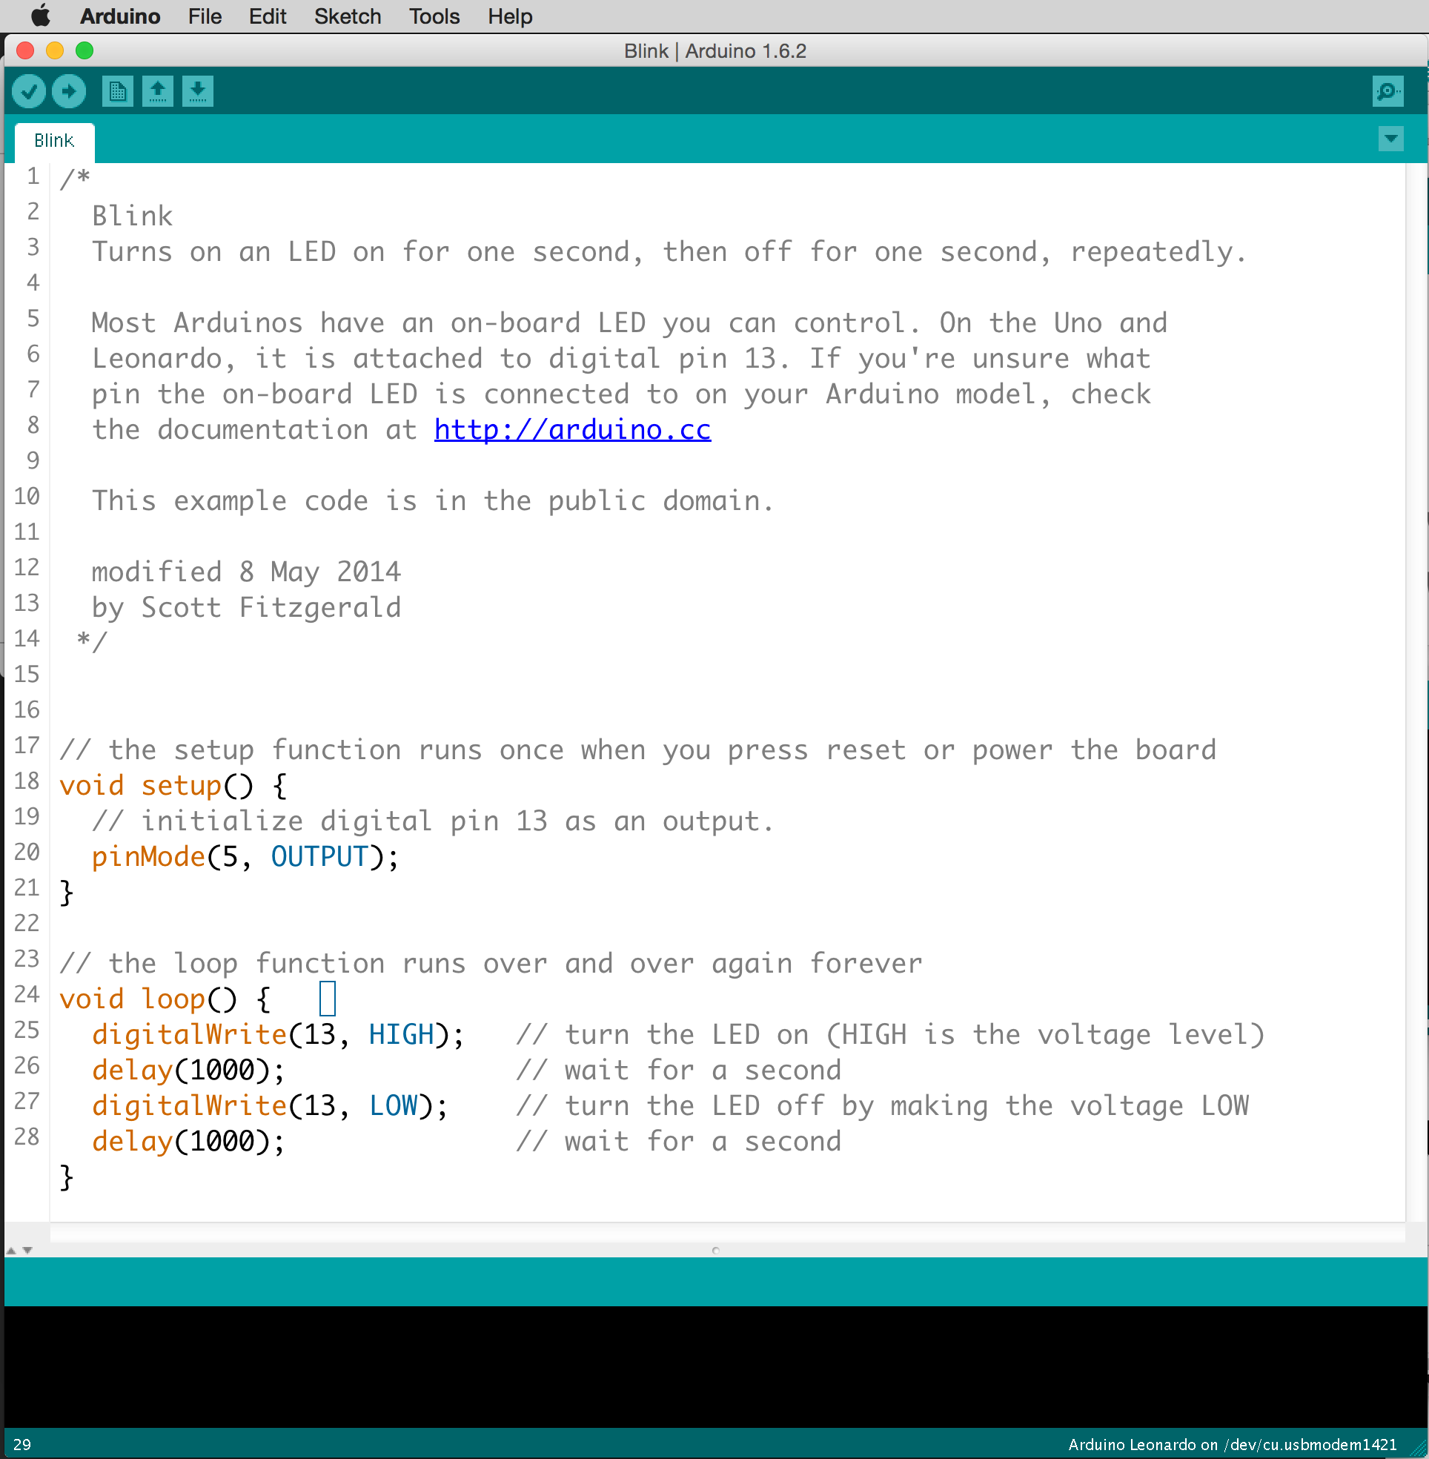
Arduino IDE
(Integrated Development Environment)

Slide 21
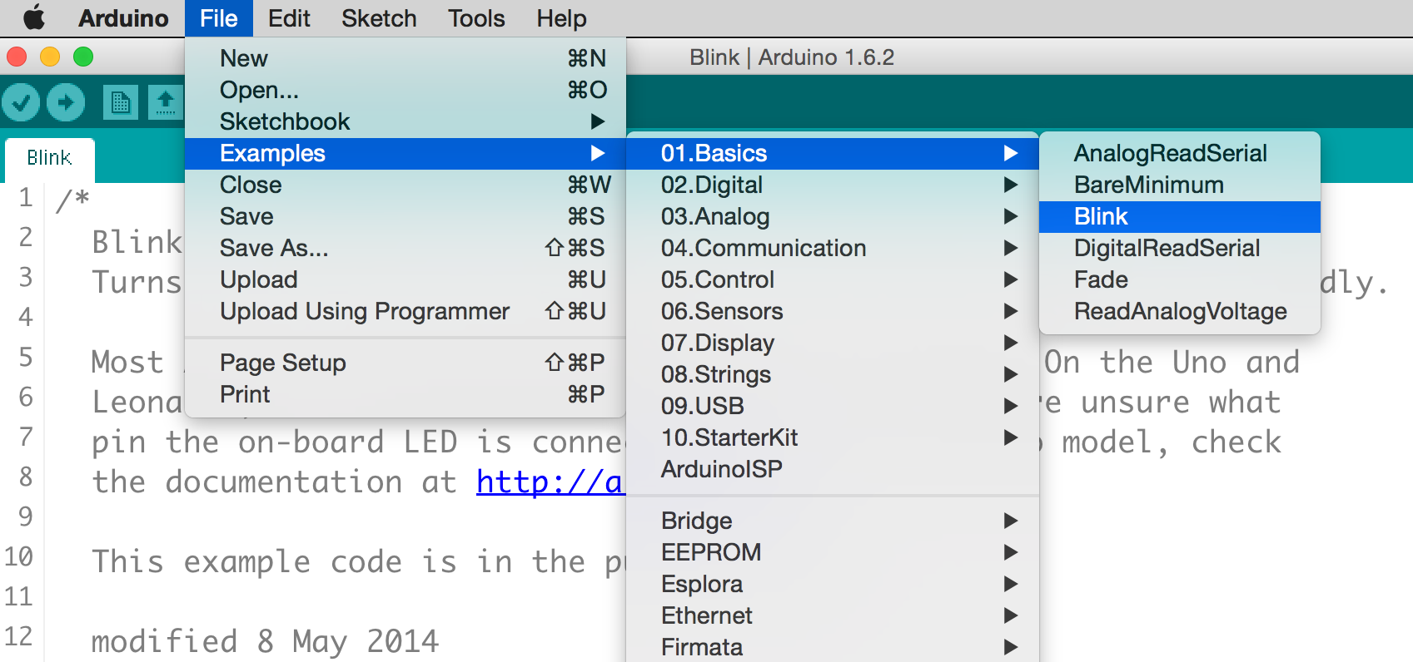
Arduino IDE
(Integrated Development Environment)

Slide 22
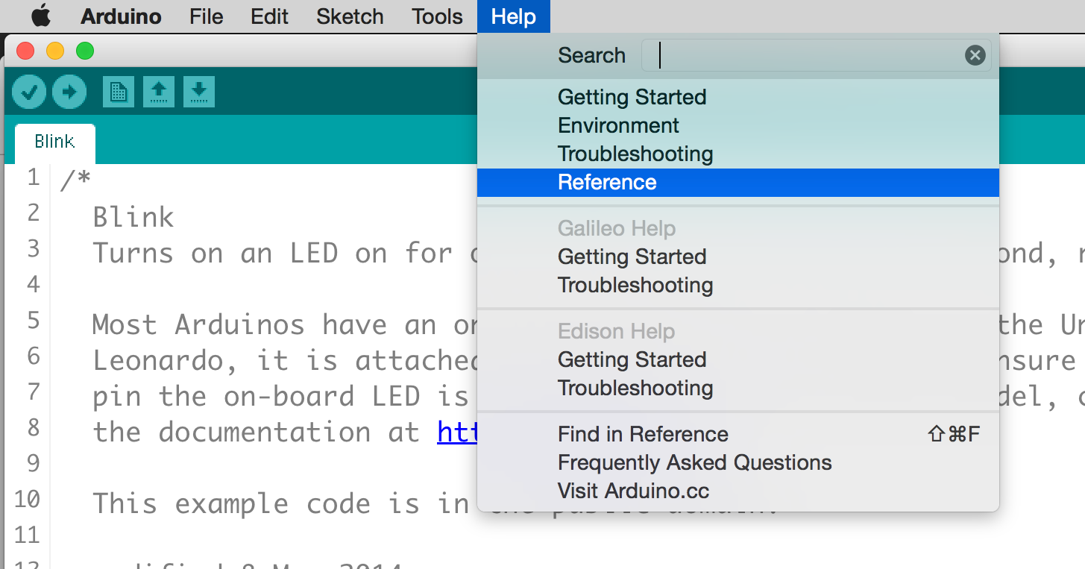
Arduino IDE
(Integrated Development Environment)

Slide 23
https://www.tinkercad.com/
Use Chrome Browser

Slide 24
https://makercommons.psu.edu/arduino/

Slide 25
Blink Test

Slide 26
Fade Test

Slide 27
Design Challenge
Modify the Ultrasonic Range Finder starter sketch to control an LED.
The LED should turn ON when the range measures below 25 inches and OFF when it measures above.
If you complete this, duplicate your sketch and vary the brightness based on the distance.

Slide 29
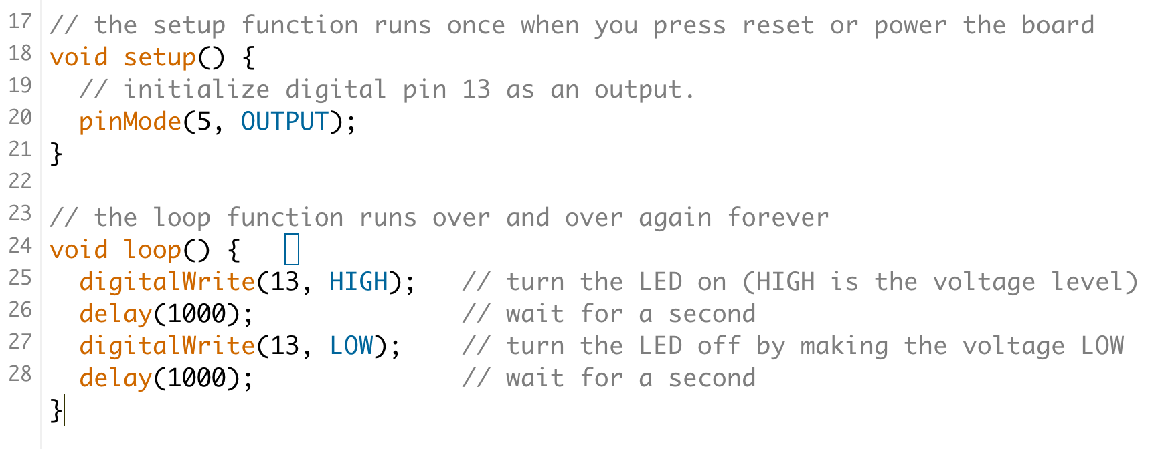
Arduino IDE
(Integrated Development Environment)

Slide 30
Arduino IDE
(Integrated Development Environment)

Slide 31
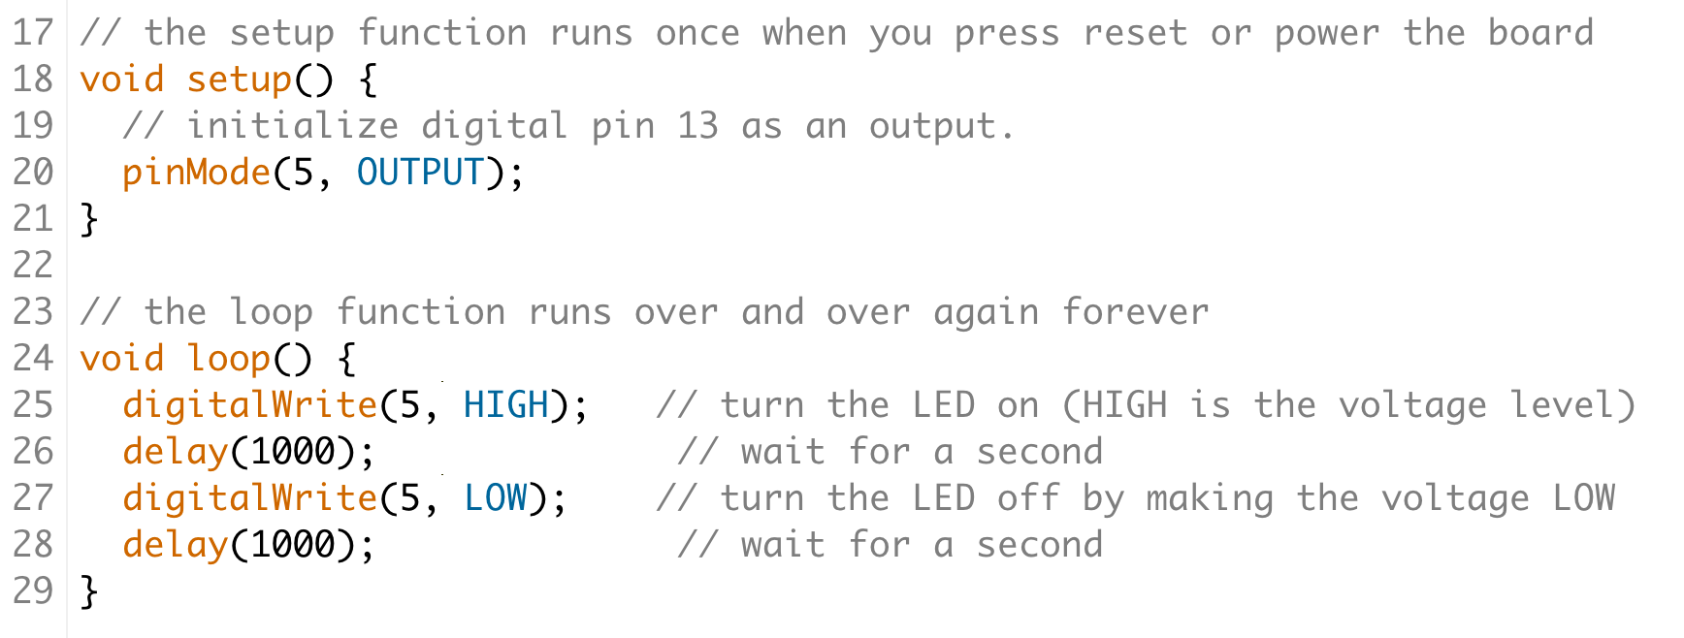
Arduino IDE
(Integrated Development Environment)

Slide 32
Arduino IDE
(Integrated Development Environment)

Slide 33
Arduino IDE
(Integrated Development Environment)

Slide 34
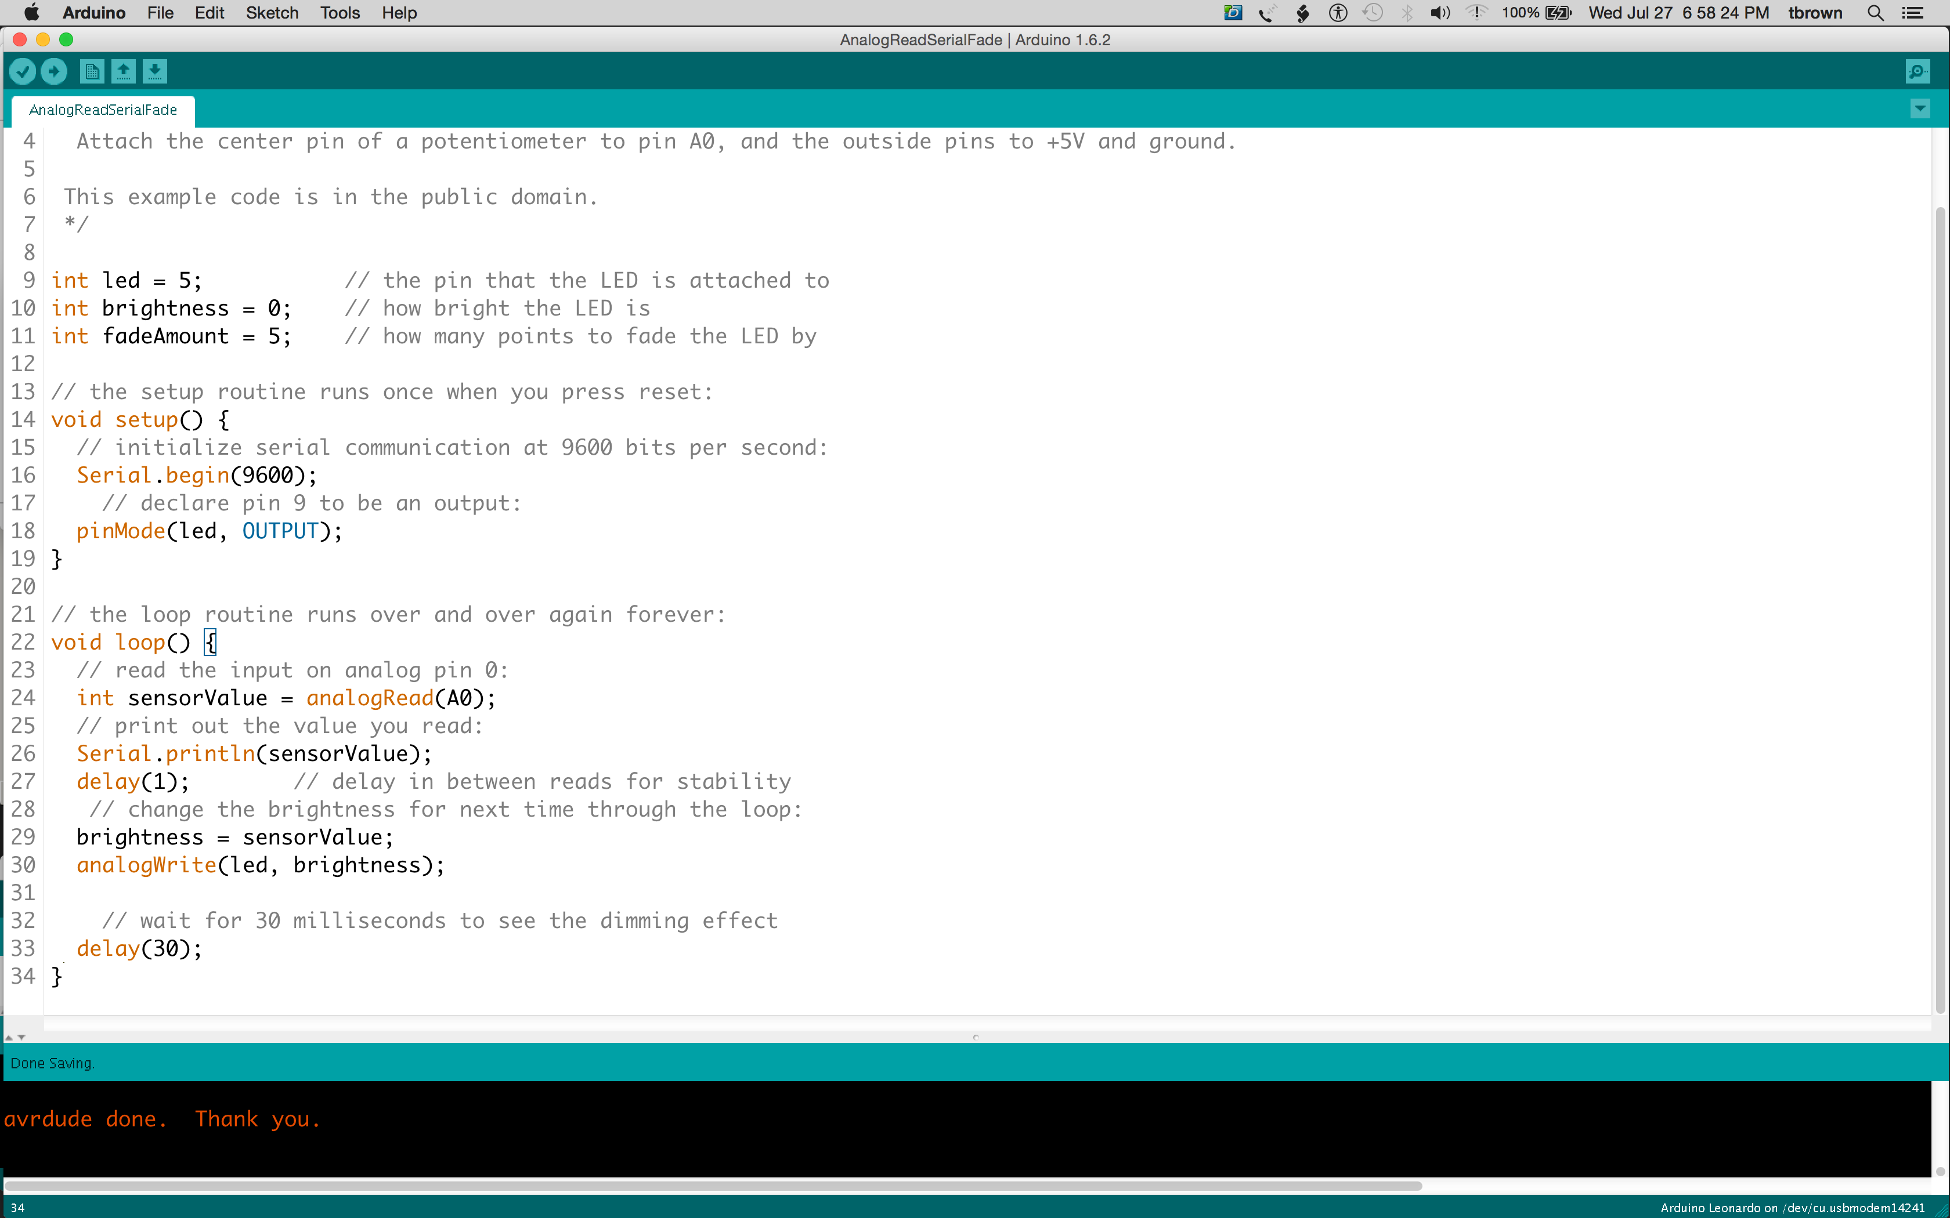
Arduino IDE
(Integrated Development Environment)

Slide 36
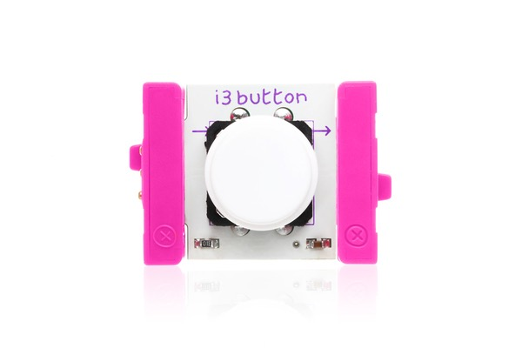
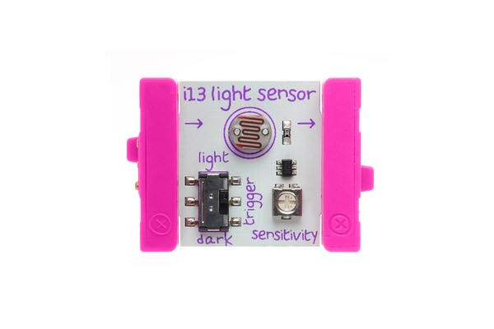
Inputs are Pink

Slide 37
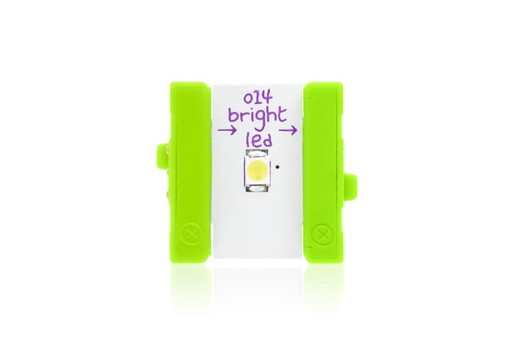
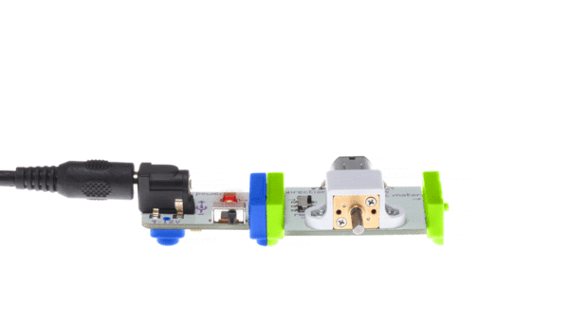
Outputs are Green

Slide 38
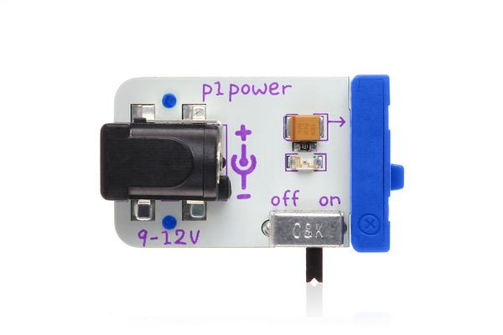
Simple Input/Output
Power is Blue

Slide 39
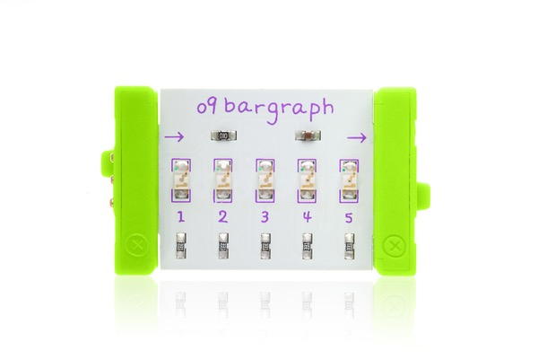
Sensor Input/Output

Slide 40
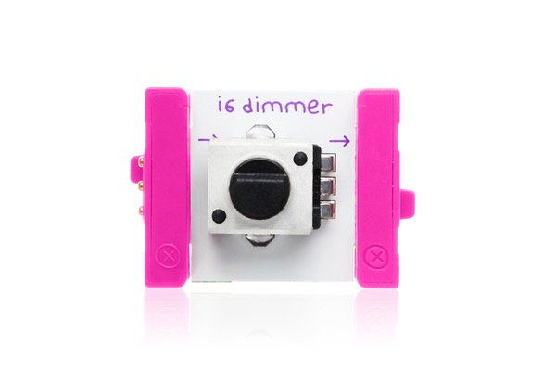
Simple Input/Kinetic Output
Connect LEGO axle and gear to motor!

Slide 41
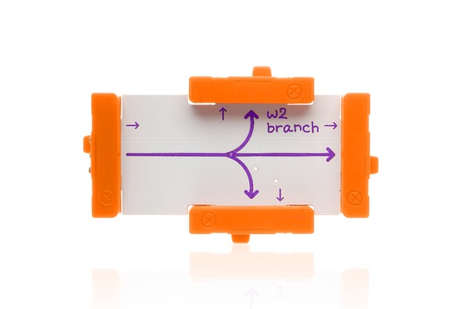
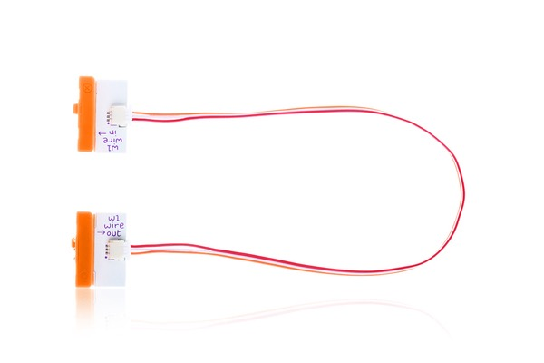
Simple Input/Kinetic Output
Connect LEGO axle and gear to motor!

Slide 42
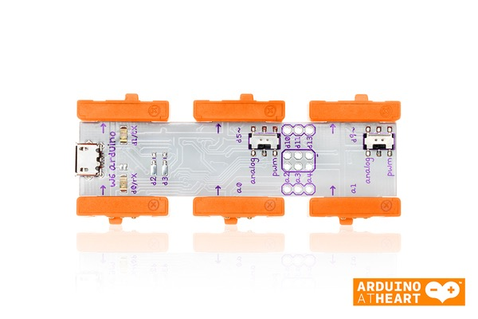
Arduino
Programmable microcontroller
Programs are called sketches
Loaded across USB
3 inputs and 3 outputs
LittleBits version of Arduino Leonard
https://www.arduino.cc/en/Main/Products

Slide 43
Arduino
d0
d1
Inputs
a0
d5
Outputs
a1
d9

Slide 44
Arduino
d0
d1
a0
d5
a1
d9

Slide 45
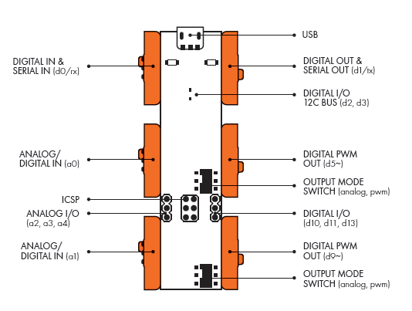
Arduino
d0
d1
a0
d5
a1
d9

Slide 46
Arduino
/*
Blink
Turns on an LED on for one second, then off for one second, repeatedly.
Most Arduinos have an on-board LED you can control. On the Uno and
Leonardo, it is attached to digital pin 13. If you're unsure what
pin the on-board LED is connected to on your Arduino model, check
the documentation at http://arduino.cc
This example code is in the public domain.
modified 8 May 2014
by Scott Fitzgerald
*/
// the setup function runs once when you press reset or power the board
void setup() {
// initialize digital pin 13 as an output.
pinMode(5, OUTPUT);
}
// the loop function runs over and over again forever
void loop() {
digitalWrite(13, HIGH); // turn the LED on (HIGH is the voltage level)
delay(1000); // wait for a second
digitalWrite(13, LOW); // turn the LED off by making the voltage LOW
delay(1000); // wait for a second
}
d0
d1
a0
d5
a1
d9

Slide 47
Design Challenge
Create a new sketch that reads the light sensor to control the brightness of the LED
Swap out LED for Servo or Motor
Add…………..

Slide 48
Resources
http://littlebits.cc/arduino-sketches
https://www.arduino.cc/en/Reference/HomePage
https://www.lynda.com/Arduino-training-tutorials/2013-0.html

