Slide 2
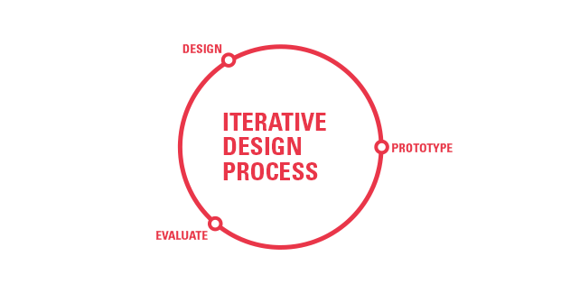

Slide 3
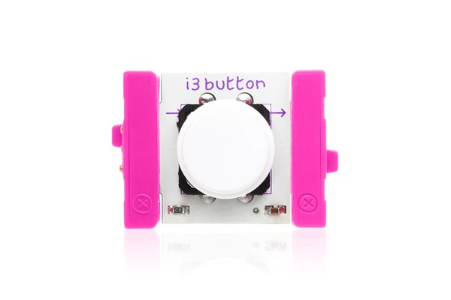
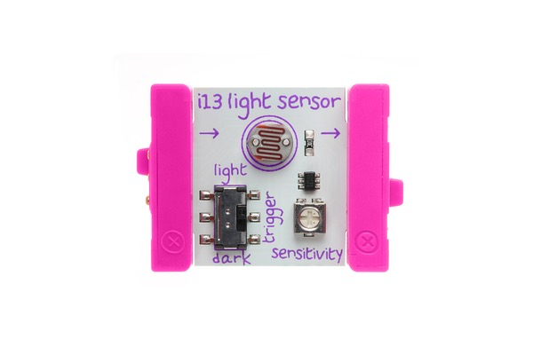
Inputs are Pink

Slide 4
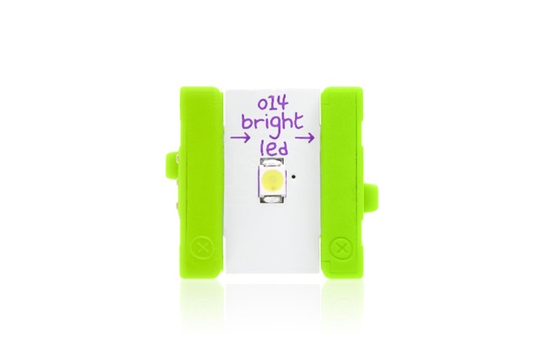
Outputs are Green

Slide 5
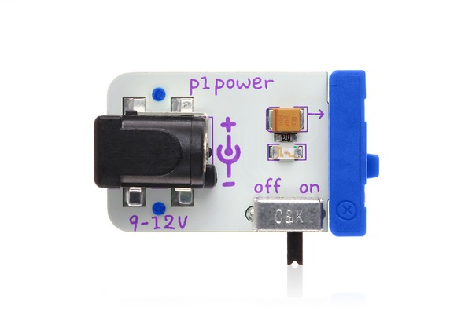
Simple Input/Output

Slide 6
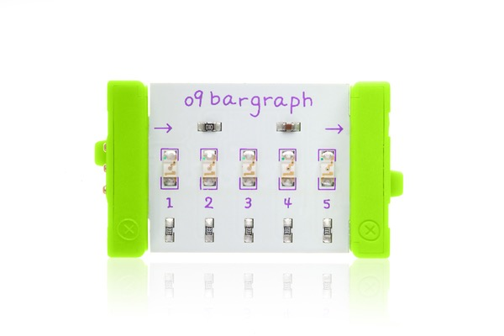
Sensor Input/Output

Slide 7
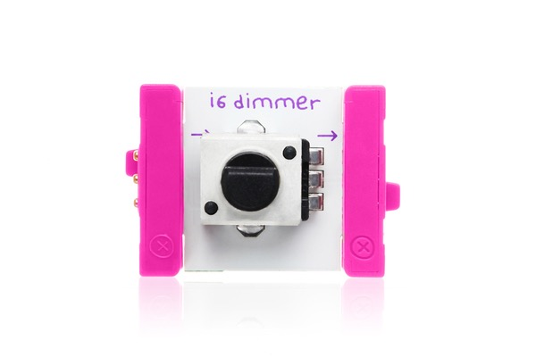
Simple Input/Kinetic Output
Connect LEGO axle and gear to motor!

Slide 8
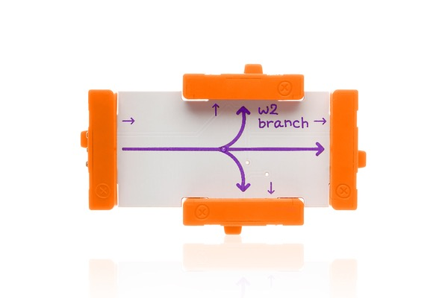
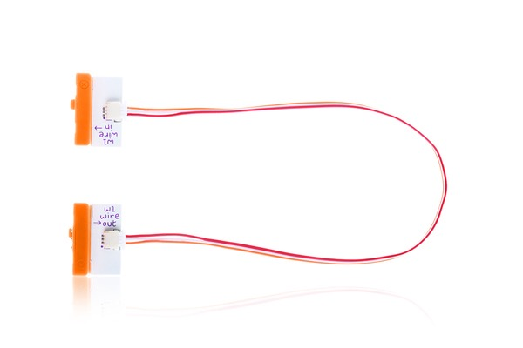
Simple Input/Kinetic Output
Connect LEGO axle and gear to motor!

Slide 9
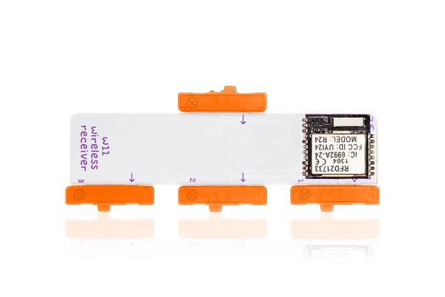
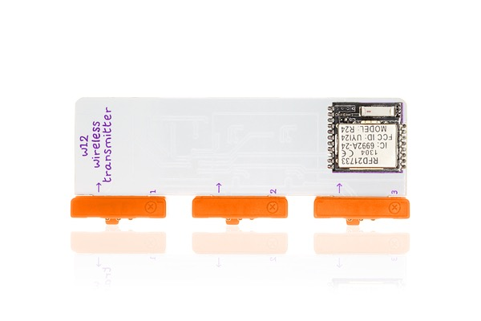
Wireless Transmitter

Slide 10
Design Challenge: Light Controlled Rover
Your team is tasked with prototyping the next iteration of a
planetary rover. Using LittleBits and additional parts,
build a rover that moves only when the sun is up:
LittleBits Kits
LEGO Adapter Plates
Rubber Bands
Scotch tape
Any LittleBits or LEGOs on the rack
20 minutes
Bonus: Add additional capabilities that your team feels might be needed

Slide 11
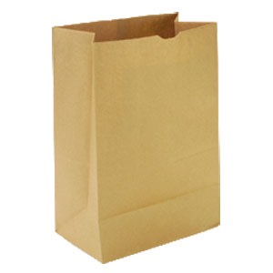
Design Challenge: Lunch Alarm
Your roommate keeps eating the lunch that you prepare
before you go to bed. Using LittleBits, build an alarm
to warn you when this happens:
Paper Bag
Apple
Rubber Bands
Scotch tape
Any LittleBits in the kits or on the rack
12 minutes

